Slide 1
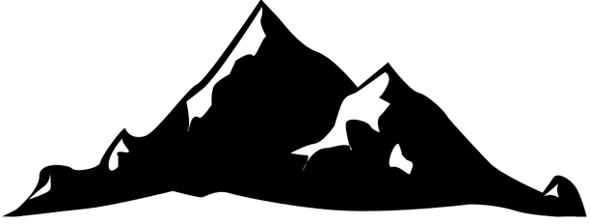

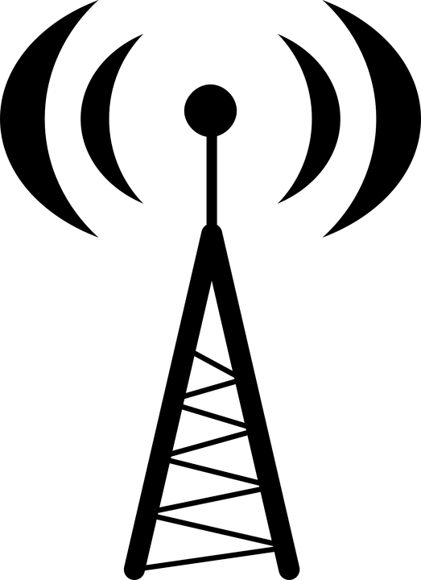


Propagation Mechanism
Diffraction
Reflection from mountains
Direct ray
Reflection from tall building
Fig: Multipath Signal at Outdoor

Slide 2
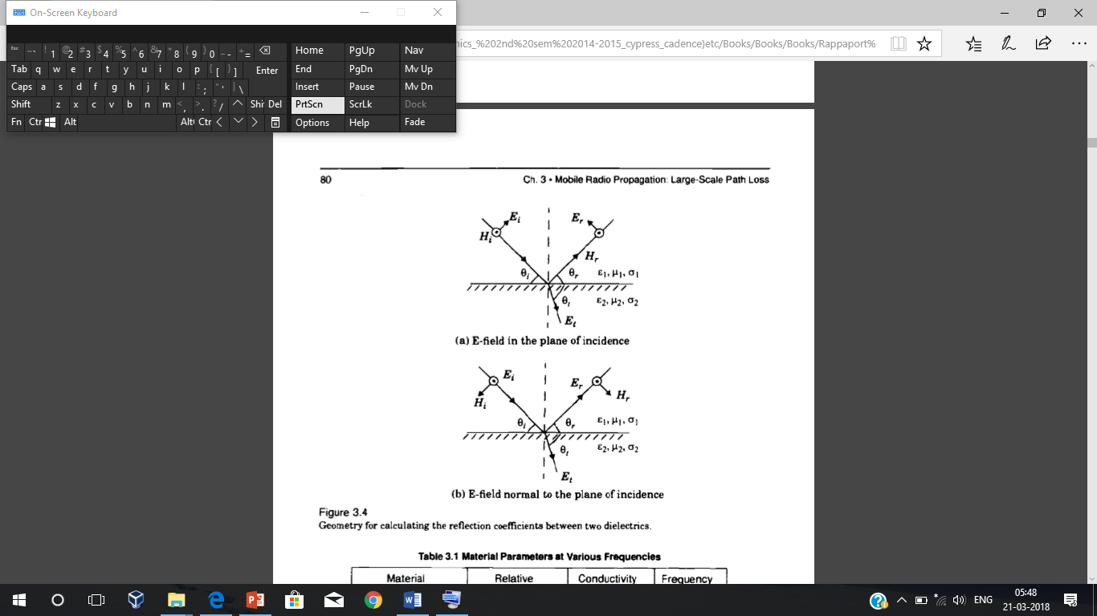
Propagation Mechanism
Reflection
Reflection occurs when the Electromagnetic waves impinge on objects which are much greater than the wavelength of the traveling wave.
Reflection from Dielectrics
Ɛ – Permittivity
σ- Conductance
μ- Permeability
Courtesy to Theodore S. Rappaport
©2002, 1996 Prentice Hall PTR

Slide 3
Propagation Mechanism
Brewster angle: Brewster's angle (also known as the polarization angle) is an angle of incidence at which wave is perfectly transmitted through surface, with no reflection.
Sin (θ_{B})= (ε₁ / (ε₁ + ε₂ )) ^{1/2}
First medium is free space:
sin (θ_{B})= (ε_{r}-1)^{1/2}/(ε_{r}²-1)^{1/2}
Reflection from perfect conductors
- EM energy cannot pass through perfect conductor
- All of its energy is reflected
Occurs only for Vertical polarization

Slide 4
Example
Calculate the Brewster angle for a wave impinging on the ground with a permittivity of 7. Assume the frequency to 200MHz.
Solution: sin (θ_{B})= (ε_{r}-1)^{1/2}/(ε_{r}²-1)^{1/2}

Slide 5
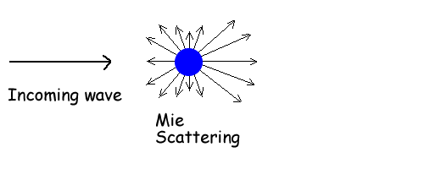
Propagation Mechanism
Scattering
This occurs when the size of the objects is less than the wavelength of the travelling wave.
Occurs when a radio wave impinges on a rough surface, the reflected energy is spread out in all directions.
Surface roughness is tested using Critical height h_{c} of surface perturbance for a given angle of incidence θi.
h_{c}= λ/8 sin θ_{i}.
A surface is considered smooth if h <h_{c} and rough if h>h_{c}.

Slide 6
Propagation Mechanism
Diffraction:
Occurs when the radio path between the transmitter and the receiver is obstructed by a surface that has sharp irregularities.
It results in bending of the waves around the object.
Diffraction from roof
Reflection from mountains
Direct ray
Reflection from tall building

Slide 7


Mobile Radio Propagation
Atmosphere
At VLF, LF, MF bands, radio waves follow the ground.
Radio Tower
Earth
Home
Ground Wave Propagation
Area between the surface of the earth and the ionosphere for transmission.
Ground wave radio signal propagation is ideal for relatively short distance propagation as the wave front of the ground wave travels along the Earth's surface it is attenuated.
Frequency of the radio signal is one of the major determining factor as losses rise with increasing frequency.
The type of antenna and its polarization has a major effect on ground wave propagation. Vertical polarization is subject to considerably less attenuation than horizontally polarized signals.

Slide 8

Ionospheric Propagation
F₂
F₁
Ionospheric Layers
HF Bands
E
D
Earth Surface
Sky wave propagation
D layer- Lowest layer existing at an average height of 70Km.It reflects VLF , LF.
E layer- Exists at an average height of 100km. It reflects MF waves.
F1 and F2 layer- Exists at a average height of 180 Km. Reflects HF waves.

Slide 9
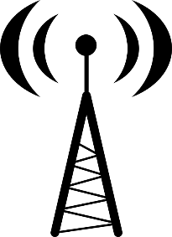
Space Wave Propagation
The radio waves having high frequencies are basically called as space waves.
Occur within the lower 20 km of the atmosphere (troposphere), and are comprised of a direct and reflected wave(Tropospherical Propagation).
Space waves can travel directly or can travel after reflecting from earth’s surface to the troposphere surface of earth.
Transmitter
Receiver
Direct wave
Frequency Bands VHF, UHF, SHF, EHF use space wave propagation.
Reflected wave
Earth Surface

Slide 10
Space wave Propagation
Limitations of space wave propagation
Space waves are limited to the curvature of the earth.
These waves have line of sight propagation, means their propagation is along the line of sight distance.
Increase the transmission distance can be done by simply extending the heights of both the sender as well as the receiver antenna.
This type of propagation is used basically in radar and television communication.
Directional antennas are used for space wave propagation.

Slide 11
Summary
The radio waves take multipath during the propagation
Radio waves get reflected, diffracted, scattered before reaching the receiver
Radio waves propagate through various modes of propagation like ground wave, Ionosphere propagation and Space wave propagation.

